Slide 1
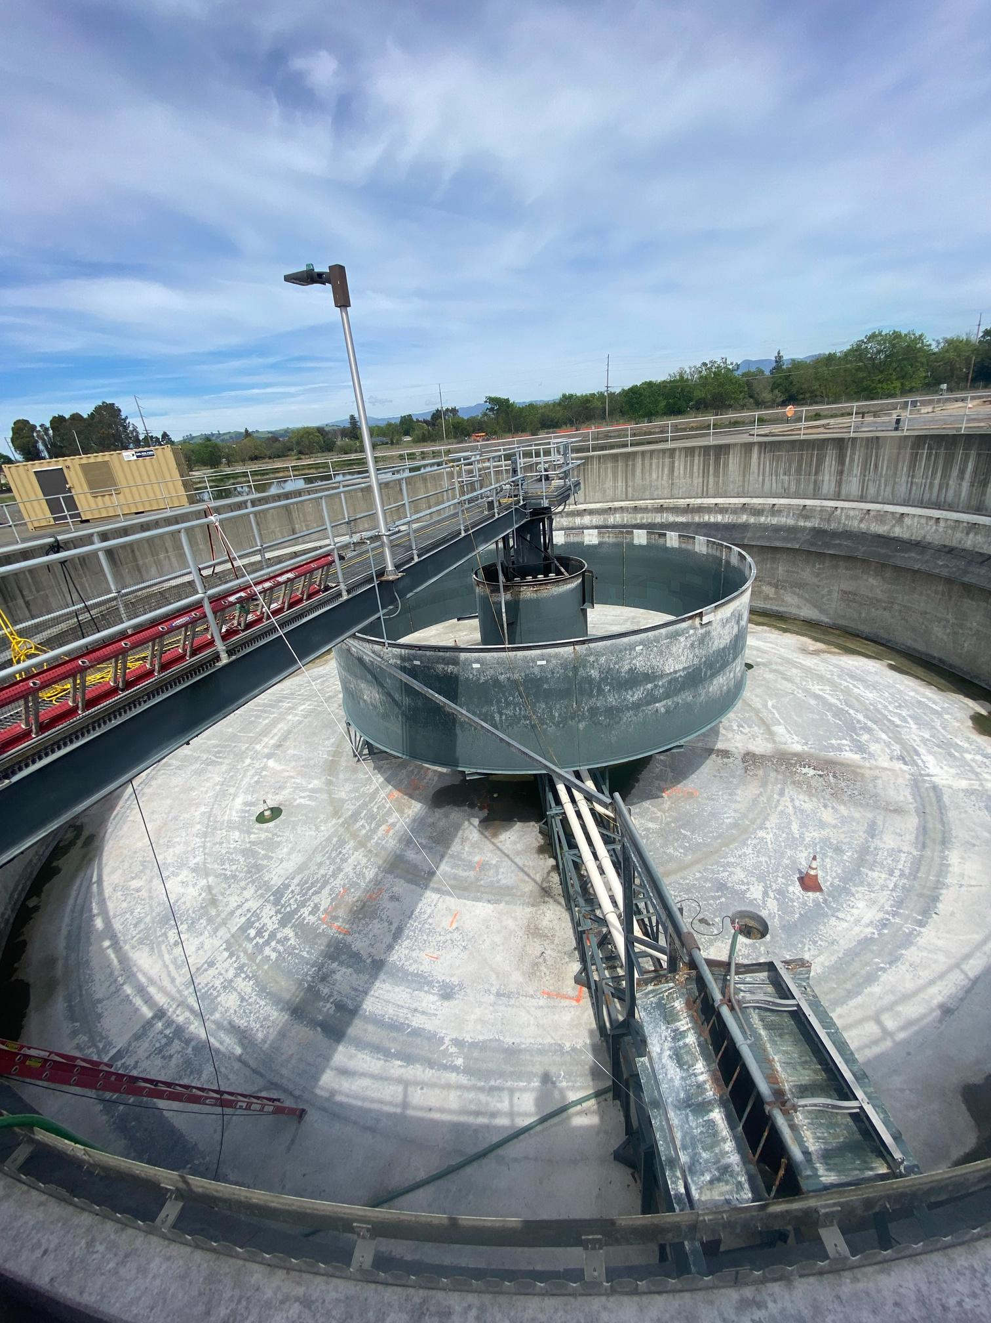

WASTEWATER &
WATER RATE UPDATE
Veronica Siwy, Town of Windsor
Mark Hildebrand, Hildebrand Consulting
Accountable. Reliable. Efficient.
February 5, 2025
Notes:
1.7.2013
February 5th Council Meeting
● Rate Study 1st Presentation (Presentation)
● Biosolids contract (Consent) = $1.4M / year
● Water Capacity Fee (Public Hearing)=growth pays for growth
● Greenhouse Gas Report (Regular)
‹#›

Slide 2
Your Water System
Infrastructure & Facilities
Russian River wells
Water main & distribution pipelines
Pump stations
Water Source & Supply
Russian River water is 100% of drinking water supply
Capital (Infrastructure) Projects Ahead
Drill 2 new wells in N. Windsor
Install treatment system on existing Esposti well
Implement a new corrosion control system
OUR
FOCUS
Drought
resiliency
Emergency
resiliency
Stabilize
Rates
Accountable. Reliable. Efficient.
Notes:
Should we add the corp yard as part of the infrastructure of your facilities?

Slide 3
Your Wastewater System
Infrastructure & Facilities
Advanced tertiary-level wastewater treatment plant
Wastewater & recycled water system mains & distribution pipelines
Clarifiers, settling ponds, UV disinfection system, storage facilities +
Capital (Infrastructure) Projects Ahead
Update aging biological treatment system to meet regulatory requirements, future growth
Class A biosolids handling facility
OUR
FOCUS
Meeting
regulations
NetZero
commitment
Cost
control
Stabilize
rates
Accountable. Reliable. Efficient.
Notes:
Should we add the corp yard as part of the infrastructure of your facilities?

Slide 4

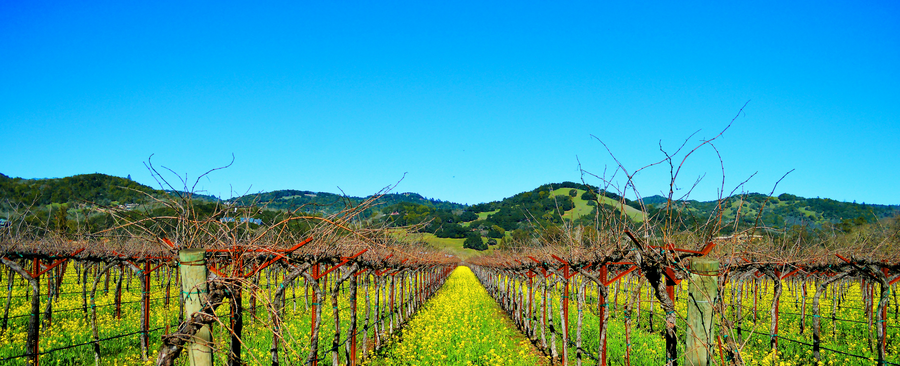

2025 Water and Wastewater
Rate Study
Final Recommenations
Presentation to Town Council
March 5, 2025

Slide 5

Agenda
Project Objectives and General Rate Setting
Water Financial Plan
Water Cost of Service and Rate Design
Wastewater Financial Plan
Wastewater Cost of Service and Rate Design
Next Steps
5

Slide 6
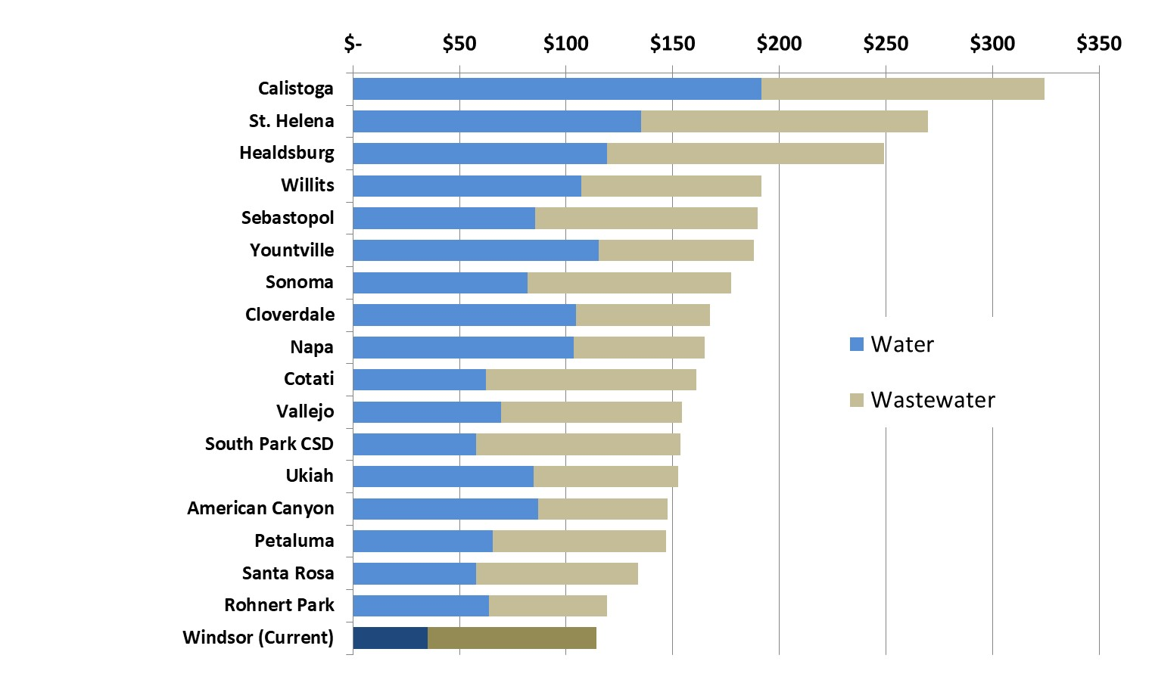
Comparative Water and Wastewater Bills for typical single family homes with median water usage
6

Slide 7
Rate Setting Objectives
In keeping with Windsor’s commitment to be efficient, reliable and accountable, this study had the following objectives:
Legal compliance
Financial sufficiency and sustainability
Minimize rate increases
Public understanding
Affordability
7

Slide 8
Legal Requirements for Setting Water & Wastewater Rates In California
Proposition 218 (Article XIIID, Section 6 of California Constitution)
  Revenues shall not exceed funds required to provide service; nor used for another purpose
  Amount shall not exceed the proportional cost of the service attributable to the parcel
  Service must be actually used or immediately available
  Approval process includes 45-day notice, public hearing, and written majority protest. Does not require a voting process (unlike taxes).
8

Slide 9
Rate Study Overview
Cost-of-Service
Rate Design
Revenue Requirements
Compare the revenues of the water and wastewater utilities to their expenses in multi-year financial plans to determine the overall level of annual rate adjustments
Proportionately allocate revenue requirements between the various customer classes based on service and demand requirements
Design water and water reclamation rates to recover the revenue requirement from each customer class and meet other rate setting objectives
9

Slide 10
Primary Model Assumptions
Annual inflation factors (starting in FY 24/25):
  Biosolids processing costs at 40% and then 10% thereafter (and then eliminated in 2029)
  Sonoma County Water Rates at 10%, then 10.7% then 10% thereafter
  Utilities at 20% for one year and then 8% thereafter
  Russian River Diversion Rates at 6% per year
  Salary & Benefit costs at 3.25%, 6% and then 3% thereafter
  General and construction at 3.0% per year
Interest earnings on reserve balances at 1.0% per year
Growth at 0.9% per year
Stable per capita water demand
10

Slide 11
Water and Wastewater
Fund Structure and Cash Flows
User Rate Revenue
Operating Fund
Operations and Maintenance
Other Revenue
e.g., fee and interest earnings
Debt Service
Capital Fund
Loan & Grant Proceeds
Capital Projects
Rate Stabilization
11

Slide 12
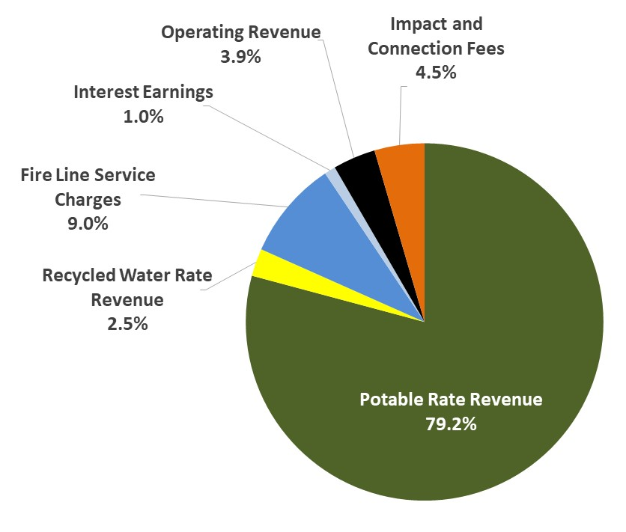
Water Revenue
Budget FY2023/24
12

Slide 13
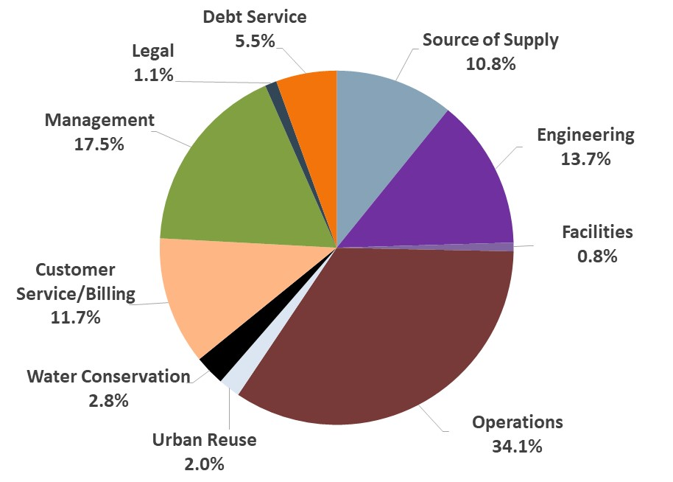
Water O&M and Debt Expenses
Budget FY2023/24
13

Slide 14
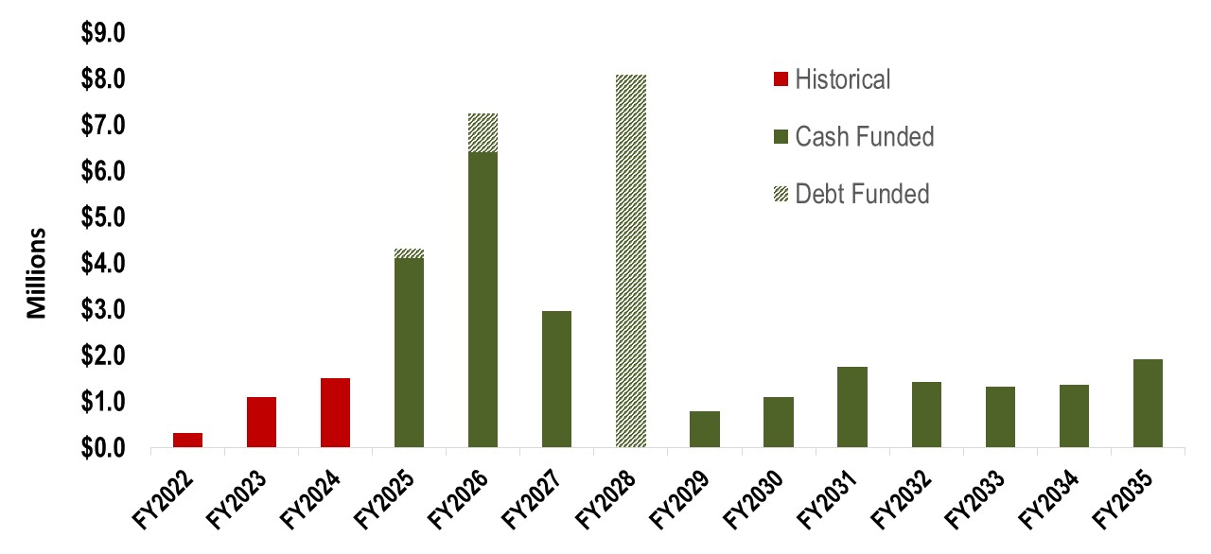
Water Capital Spending
$9.1 million in new debt
3-Year PayGo Average: $975 thousand
10-Year PayGo Average:
$1.9 million
14

Slide 15
Water Financial Forecast
15

Slide 16
Water Rate Structure
Usage rates (Town and Airport)
  3-tiers for most residential
  Uniform rate for commercial
  Seasonal rates for irrigation
Fixed service charges by meter size
Pressure zone pumping charges
Recycled water rates
16

Slide 17



Residential Tiered Water Rates
Tier 3
Blended Water Supply
Costs & Conservation
More than 17,000 gallons per month
Blended Water Supply
Costs & Conservation
Tier 2
10,000 gallons per month
Town Wells
costs
Tier 1
7,000 gallons per month
Median User
Average User
High User
Very High User
17

Slide 18
Proposed Water Rate Schedules
18

Slide 19
Proposed RecycledWater Rate Schedules
19

Slide 20
Water Bill Impacts
20

Slide 21
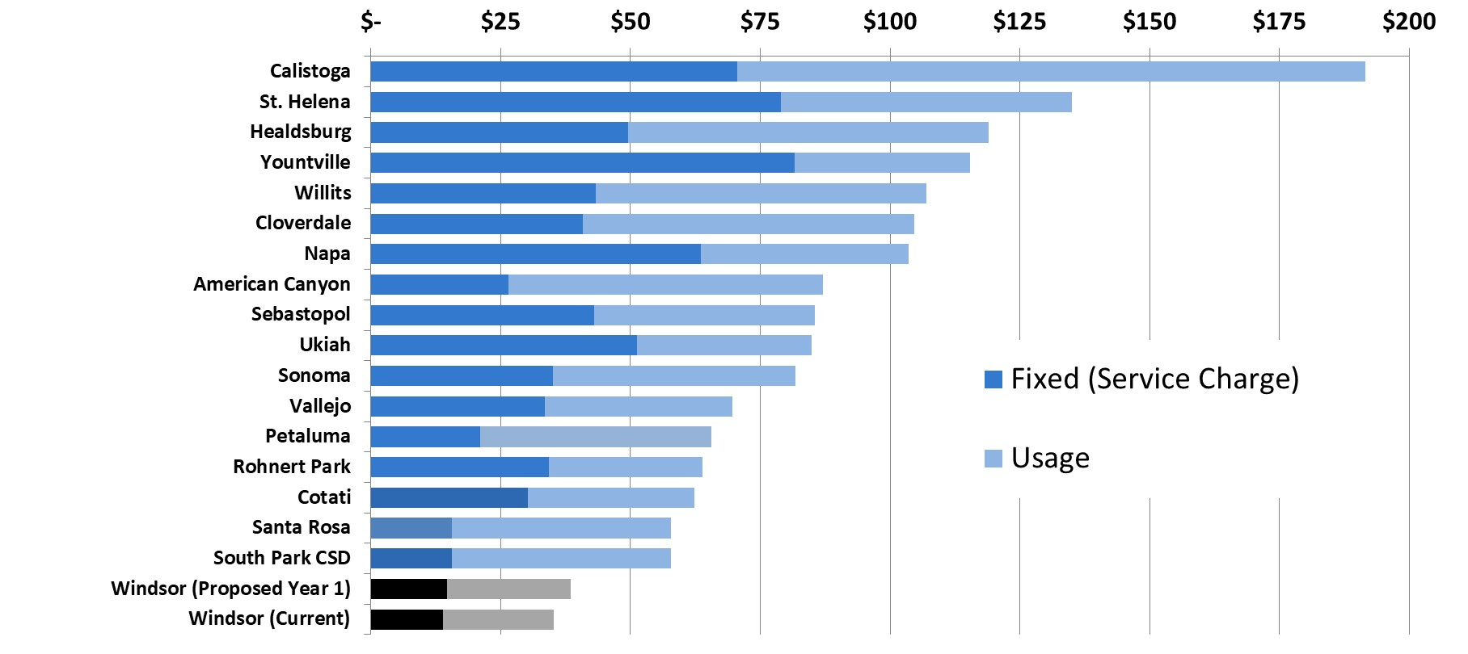
Comparison to Other Local Agencies – Water Charges for single family homes with ¾” meter and 6,000 gallons of water usage
21

Slide 22
Wastewater Revenue
Budget FY2023/24
22

Slide 23
Wastewater O&M and Debt Expenses
Budget FY2023/24
23

Slide 24
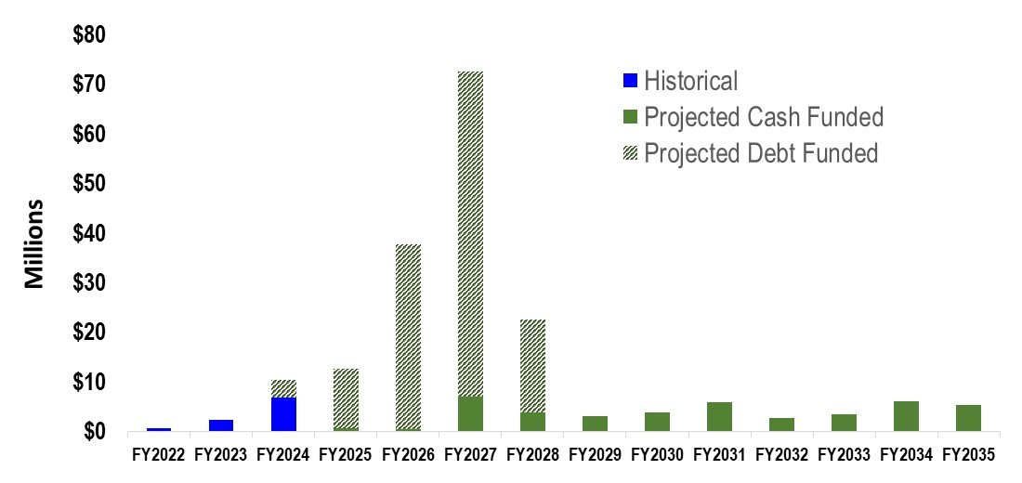
Wastewater Capital Spending
$127 million in new debt
3-Year PayGo Average: $3.2 million
10-Year PayGo Average:
$3.8 million
24

Slide 25
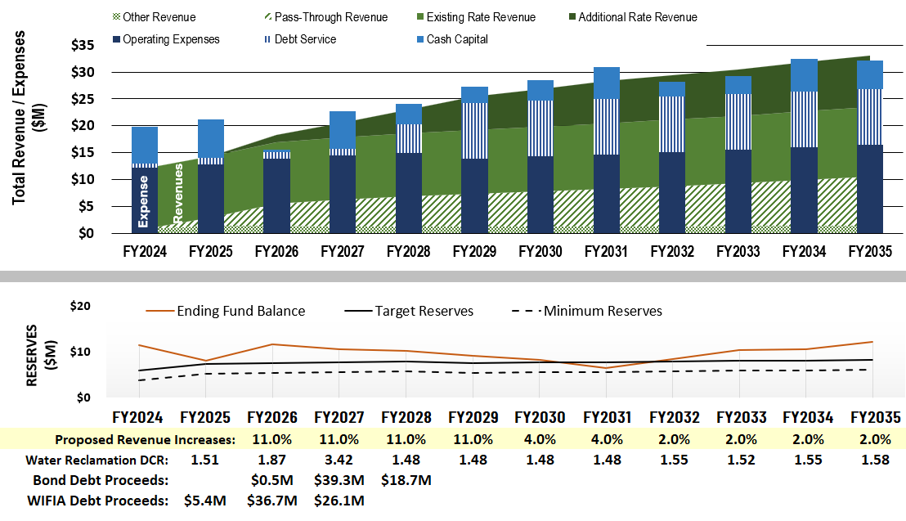
Wastewater Financial Forecast
25

Slide 26
Wastewater Rate Structure
Usage rates:
  Residential
  Commercial
    Low strength
    Medium strength
    High strength
Fixed service charges
  Per dwelling unit for single family and multi-family
  By meter size for commercial
Lift station service charges
26

Slide 27
Proposed Wastewater
Rate Schedules
27

Slide 28
Wastewater Bill Impacts
28

Slide 29
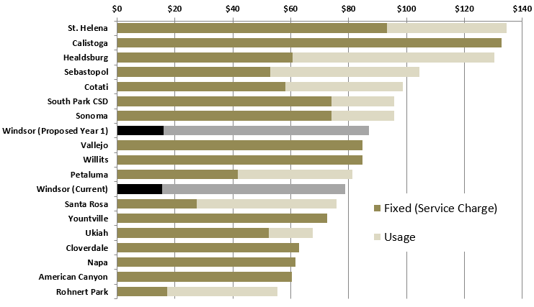
Comparison to Other Local Agencies – Wastewater Charges for single family homes with ¾” meter and 3,000 gallons of winter water usage
29

Slide 30
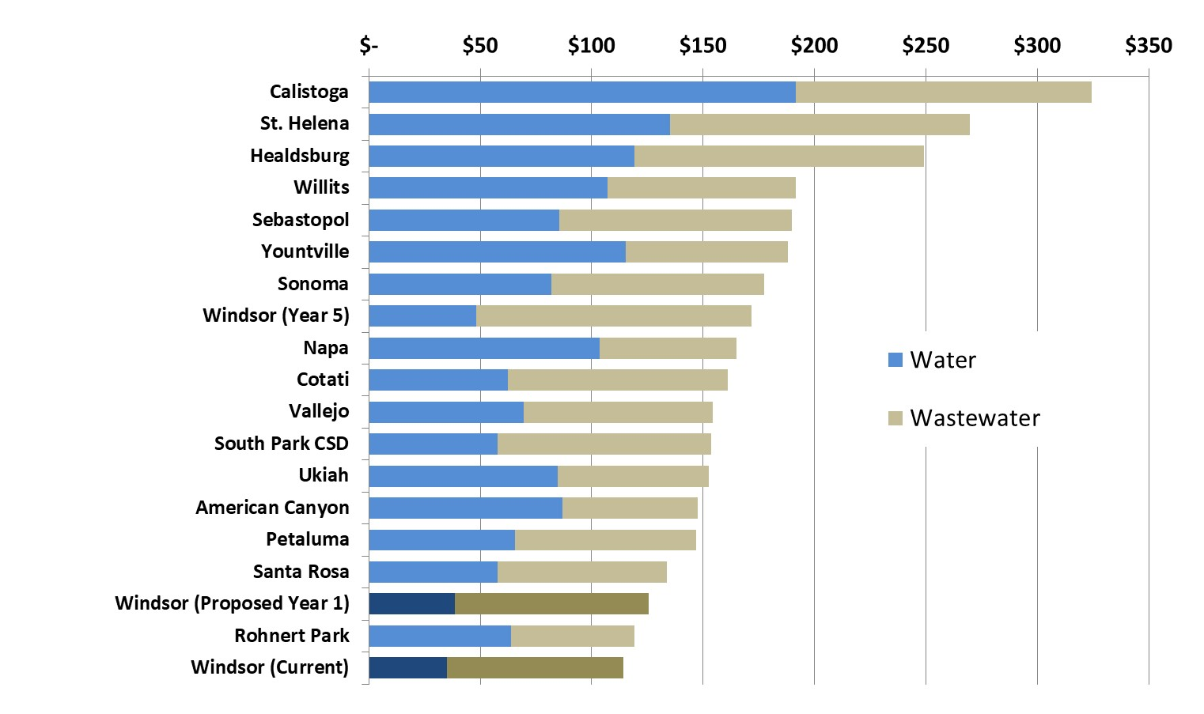
Comparison to Other Local Agencies – Combined for Single Family Accounts
30

Slide 31
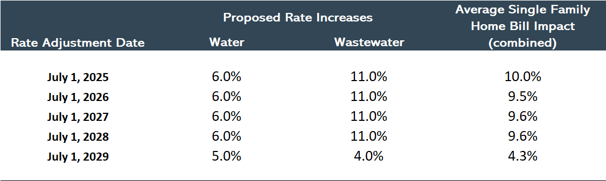
Summary of Proposed Rate Adjustments
In Year 1, average single family accounts will experience a:
$3.24 increase to their water bill
and a
$8.82 increase to their wastewater bill.
31

Slide 32






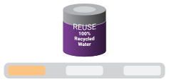



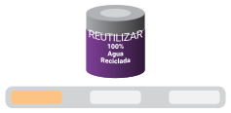







DECEMBER 2024
PUBLIC ENGAGEMENT
    Community meetings (virtual & in-person)
    Speaking presentations (organizations & groups)
    Council presentations & hearings
    Utility bill inserts (bi-lingual)
    Web portal
    E-blasts (bi-lingual)
    Social media (bi-lingual)
    WaterSmart (emails, pop-ups, bi-lingual)
    Outreach events
We’re 100%
Committed
Clean Energy • Recycled Water • Biosolids Reuse
DICIEMBRE 2024
Estamos 100%
Comprometidos
Energía Limpia • Agua Reciclada • Reutilización de Biosólidos
Complete!
75% Complete
25% Complete
Accountable. Reliable. Efficient.
Windsor is strongly committed to environmental sustainability and reducing our carbon footprint. Our small town with big solutions will soon be home to the first NetZero Wastewater Treatment Plant in the world. We are making great strides thanks to grant funding and rate revenue.
Completo
75% Completo
25% Completo
Windsor está firmemente comprometida con la sostenibilidad medioambiental y la reducción de nuestra huella de carbono. Nuestro pequeño pueblo con grandes soluciones pronto tendrá la primera planta de tratamiento de aguas residuales con cero emisiones netas (NetZero) del mundo. Estamos avanzando a grandes pasos gracias a las subvenciones e ingresos por tasas.
Save our customers money
Provide a better quality of life
Reduce our environmental footprint
Ahorrar dinero en beneficio de nuestros clientes
Mejorar la calidad de vida
Reducir nuestra huella medioambiental
Learn more: townofwindsor.ca.gov/1436/NetZero-Wastewater
Más información: townofwindsor.ca.gov/1436/NetZero-Wastewater

Slide 33

Low-Income Assistance Program
CALIFORNIA LAW
CA law does not allow one class of customers to subsidize another class using rate funds.
A low-income assistance program can be funded with non-rate revenue from late fees, service shut-off fees, general fund, etc.
Accountable. Reliable. Efficient.

Slide 34
Timeline
Mid March
Mail notification of Public Hearing
Accountable. Reliable. Efficient.
May 7
Public Hearing
July 1
First rate increase

Slide 35
EXTRA SLIDES
35

Slide 36
Project Objectives and
General Rate Setting
36

Slide 37
Primary Model Inputs
Fund and reserve balances as of June 30, 2023
FY 2023/24 actual revenues and expenses
Existing debt service schedules
FY 2023/24 utility billing data
37

Slide 38
Wastewater Fund Structure and Cash Flows
User Rate Revenue
Operating Fund (410)
Operations and Maintenance
Other Revenue
e.g., fee and interest earnings
Debt Service
Capital Fund (430)
Loan Proceeds
Capital Projects
Rate Stabilization (420)
38

Slide 39
Water Capital Program
Additional water supply (production wells)
Replacement of aging infrastructure
Corrosion
  Including changes to regulations lead & copper
Potable recycled water offset program
39

Slide 40
Water Reserve Targets
Strong financial practices/policies are in the interest of rate payers by protecting Windsor against unforeseen circumstances and contributing towards a strong credit rating.
    Policies :
    Operating Reserve: For changes in operating costs or disruption in revenue.
    Existing Policy = 25% O&M costs (current target approximately: $1.7 million)
    Capital Reserve: Ensures timely response to natural disasters and/or other emergencies.
    Proposed Target = 50% of projected PayGo capital budget (currently $1.4M)
    Rate Stabilization: Set at $1.25 million consistent with historical practice
    Current Total Target = $4.3 million
40

Slide 41
Wastewater Capital Program
Net Zero Program, which includes:
    Biosolid Handling
    Secondary Process Upgrade/WWTP Upgrades
    Sustainable energy projects
Infrastructure modernization
Addressing deferred maintenance
Controlling external costs through in-house operations
41

Slide 42
Wastewater New Debt Assumptions
42

Slide 43
Wastewater Reserve Targets
Strong financial practices/policies are in the interest of rate payers by protecting Windsor against unforeseen circumstances and contributing towards a strong credit rating.
    Policies :
    Operating Reserve: For changes in operating costs or disruption in revenue.
    Existing Policy = 25% O&M costs (current target approximately: $3.2 million)
    Capital Reserve: Ensures timely response to natural disasters and/or other emergencies.
    Proposed Target = 50% of projected PayGo capital budget (currently $2.2M)
    Rate Stabilization: Ensures that debt requirements are met.
    Proposed Target: $2.0 million (up from $750 thousand due to increase in debt service)
    Current Total Target = $7.4 million
43

Slide 44
Combined Bill Impacts
44

